Slide 1
Access & Analysis of MODIS NDVI Over the Sao Francisco Verdadeiro Watershed
15 November, 2022
Notes:
Access and analysis of MODIS NDVI (Normalized Difference Vegetation Index) Over the Sao Francisco Verdadeiro (SFV) Watershed

Slide 2
Objectives
By the end of this exercise, you will be able to download and analyze NDVI (Normalized Difference Vegetation Index) over the SFV watershed and examine inter-annual differences
Requirements
QGIS installed on your computer
https://arset.gsfc.nasa.gov/sites/default/files/water/drought/Introduction%20to%20QGIS.pdf
A shapefile for the Sao Francisco Verdadeiro watershed saved on your computer
http://arset.gsfc.nasa.gov/
NASA Earthdata Account

Slide 3
Outline
Part 1: Search and Download MODIS NDVI Data
Part 2: Analyze Inter-Annual Differences in NDVI using QGIS

Slide 4
Note
We will be analyzing MODIS NDVI product from Terra, MOD13Q1 Version 006
https://lpdaac.usgs.gov/dataset_discovery/modis/modis_products_table/mod13q1
MOD13Q1 has spatial resolution of 250 m and temporal resolution is 16 days
The NDVI values vary from -1 to 1, where negative to 0 indicate no vegetation and 1 indicates maximum vegetation

Slide 5
Part 1: Search and Download MODIS NDVI

Slide 6
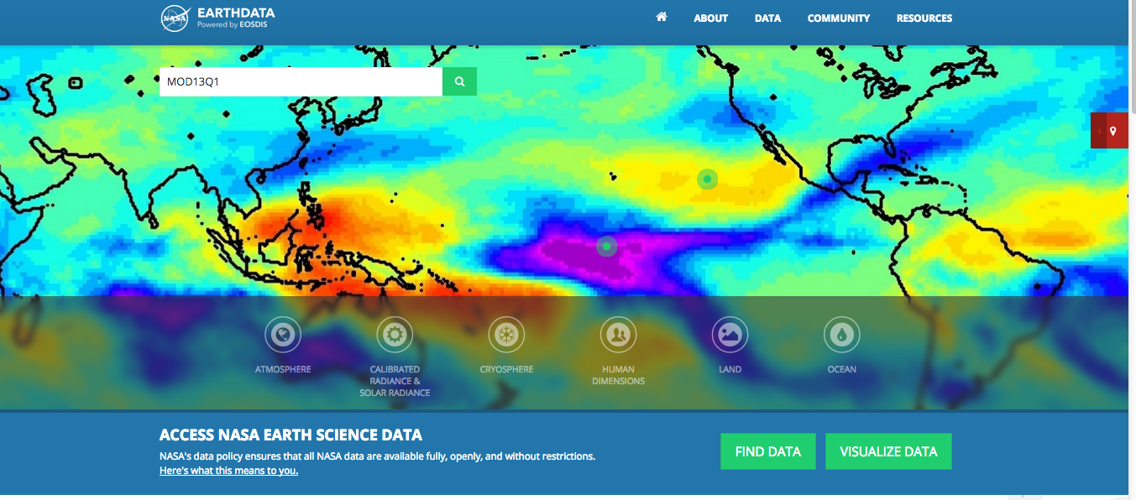
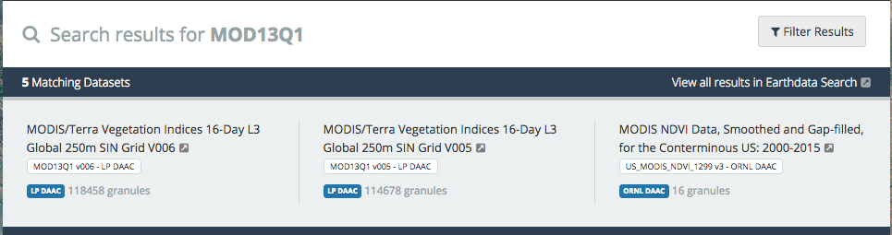
Search and Download NDVI Data
On your computer make a folder named NDVI
Go to https://earthdata.nasa.gov/
In the Earthdata search window enter MOD13Q1 and click on the looking glass next to the window
You will get a list of products under Search results for MOD13Q1
Click on the MODIS/Terra Vegetation Indices 16-Day L3 Global 250m Sin Grid V006 product
You will see Earthdata Login button at the top right to login to your account

Slide 7
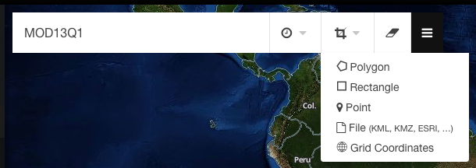
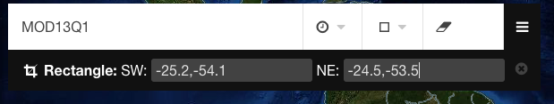
Search and Download NDVI Data
Use your mouse to scroll over Brazil
In the Search bar at the top, type in MOD13Q1
Click on the Spatial Subset icon, select Rectangle, enter the latitude and longitude coordinates close to the SFV watershed
SW: -25.2,-54.1
NE: -24.5,-53.5

Slide 8
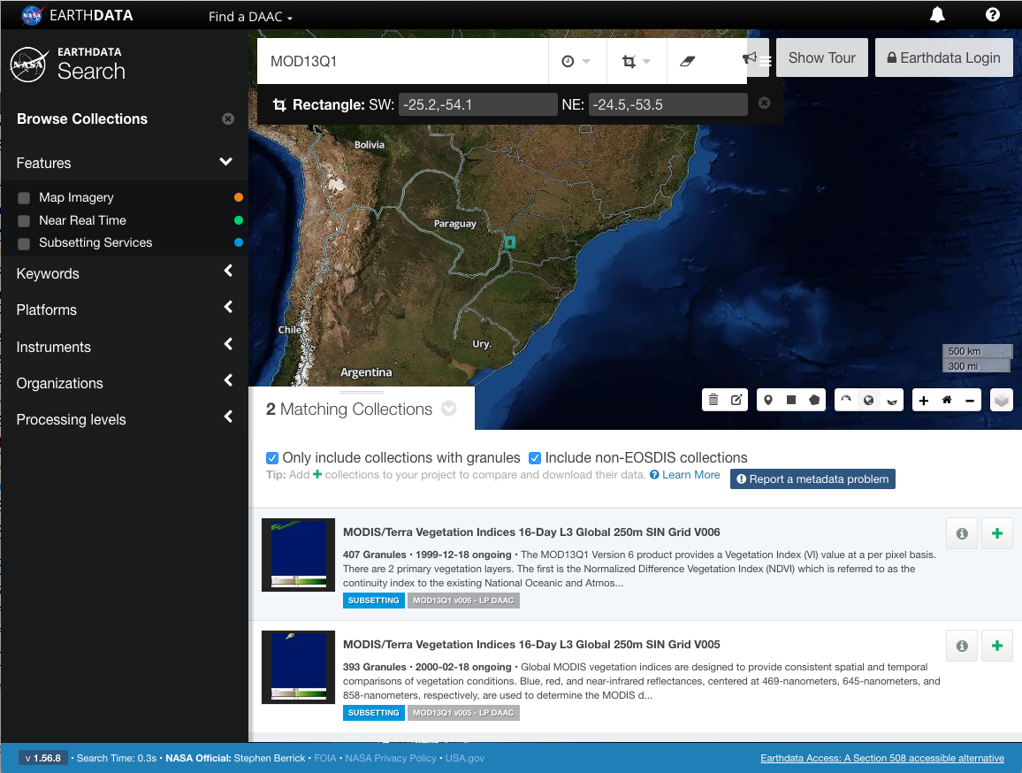
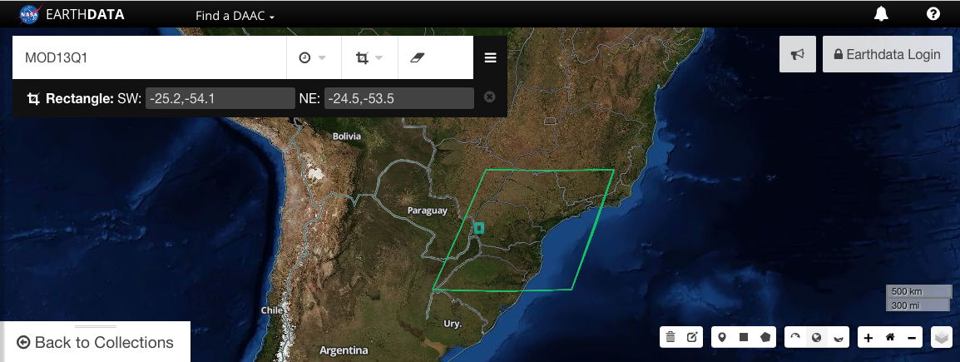
Search and Download NDVI Data
Click on MODIS/Terra Vegetation Indices 16-Day L3 Global 250m SIN Grid V006 in the collections list
You will see available MODIS swath outline on the map

Slide 9
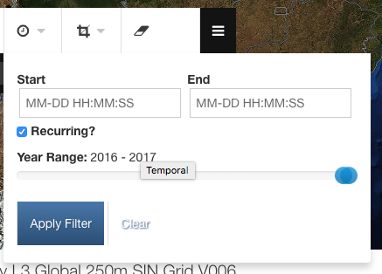
Search and Download NDVI Data
Click on the Temporal subset box
Check the Recurring box. This will provide a Vegetation Indices file for selected dates throughout the year range and will exclude all other dates
Move the blue circle under Year Range so that 2016-2017 is displayed
Put your cursor in the Start box, then select February, February 1
Put your cursor in the End box, then select February, then February 28
Click Apply Filter

Slide 10
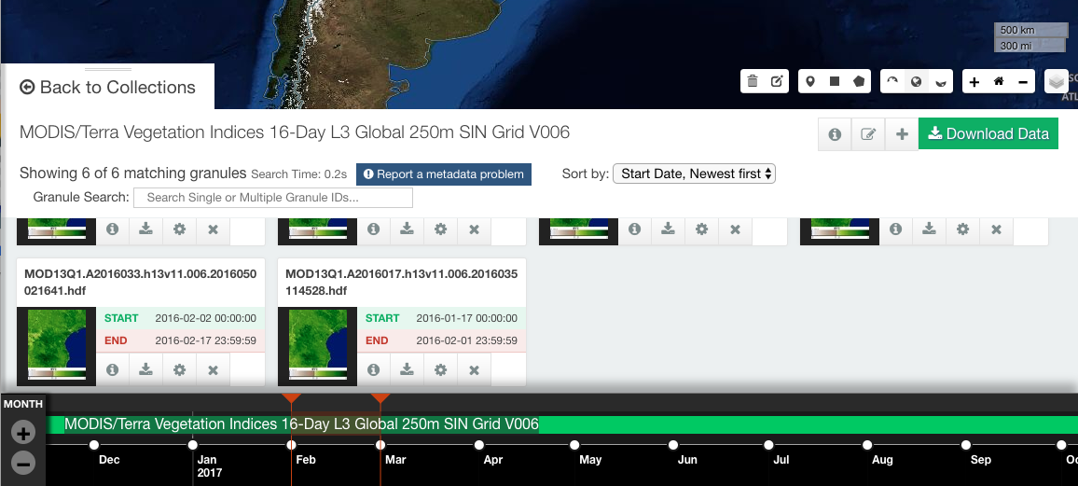
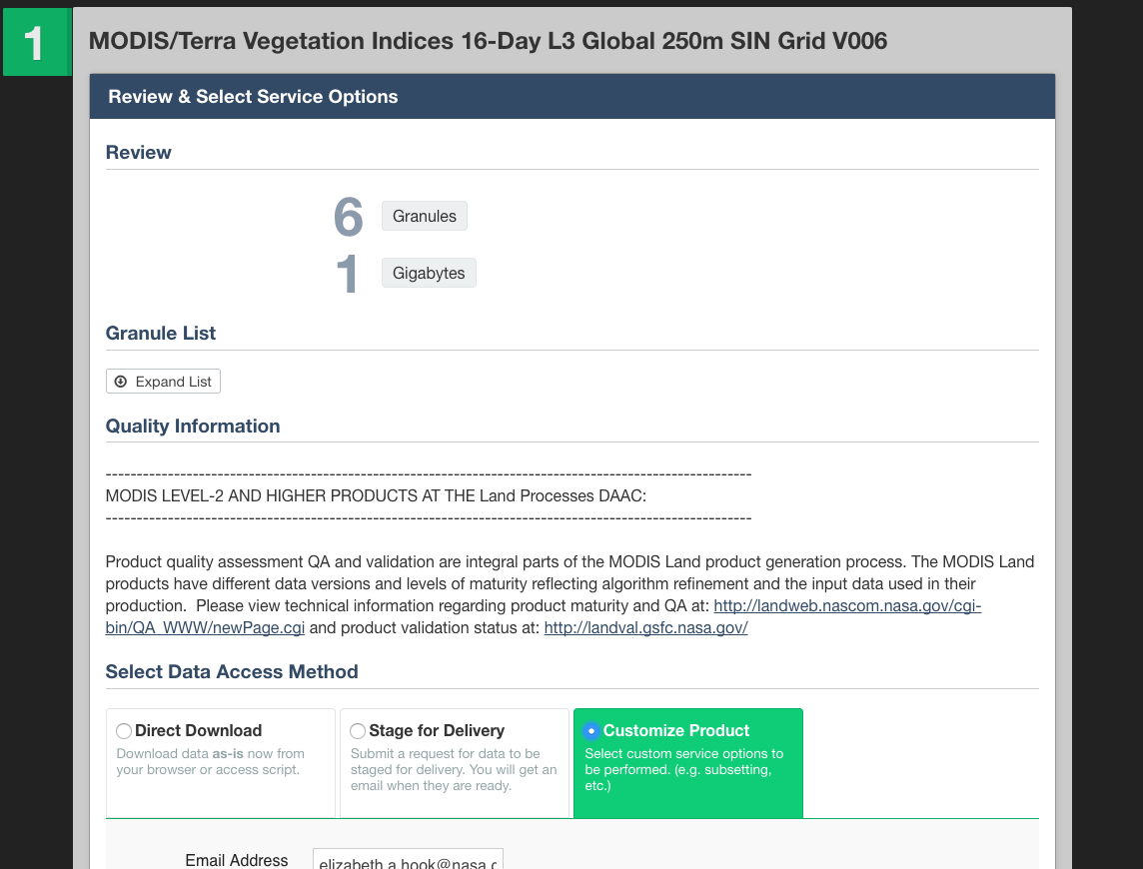
Search and Download NDVI Data
You will get a list of six MODIS NDVI swaths available for the selected periods
Click on the Download Data button on the right
You will be directed to the Data Access page. You can select specific options for your data type and delivery method
Under Select Data Access Method, choose the Customize Product option

Slide 11
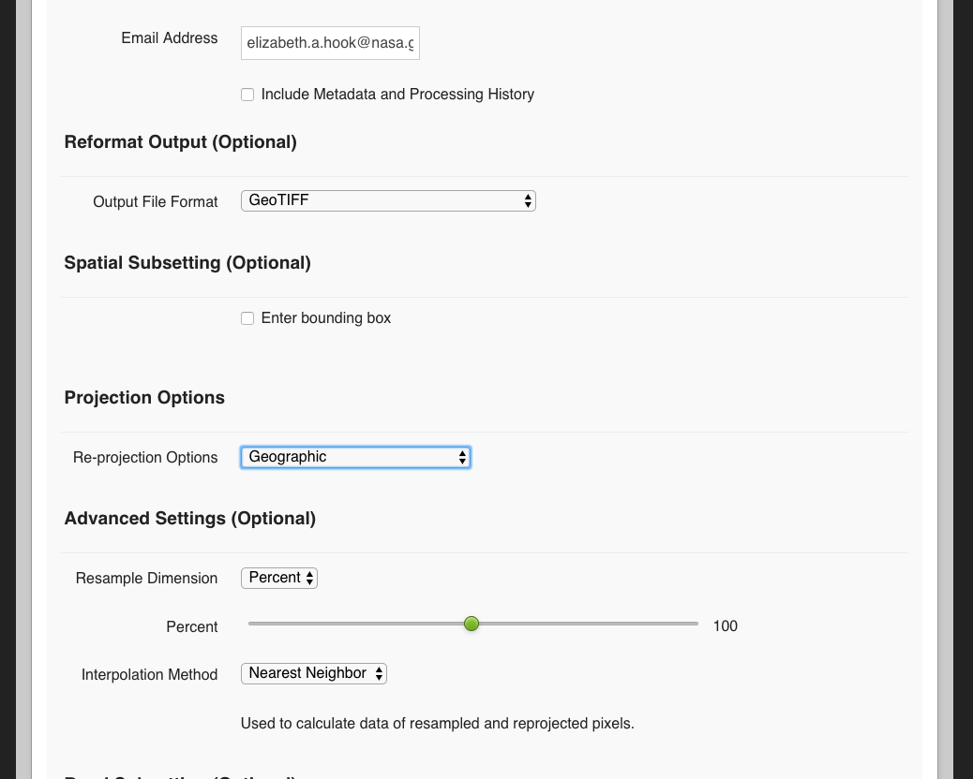
Search and Download NDVI Data
Confirm that your email address is correct
For Reformat Output (Optional), select GeoTIFF
Leave Spatial Subsetting (Optional) unchecked
Under Projection Options, set Reprojection Options to Geographic
Leave the default Advanced Settings

Slide 12
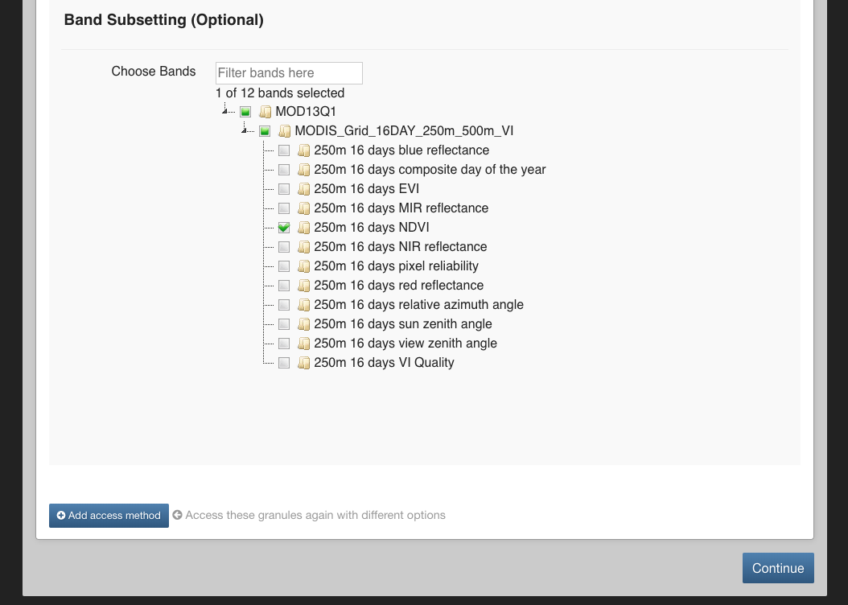
Search and Download NDVI Data
Under Band Subsetting (Optional), click the arrow next to MODIS_Grid_16DAY_250m_500m_VI. This should display all bands, or products, available.
We are only interested in downloading the 250 m 16 days NDVI option. Uncheck every other band option
Click Continue on the bottom right

Slide 13
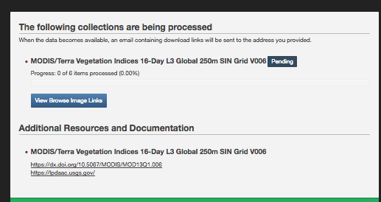
Search and Download NDVI Data
Review your contact information on the next page and click Submit
Your data download will begin to process. Keep this page open. You will be sent an email when the processing is complete and you will be provided with a direct download link
Once the processing is complete, click on the .zip file and save it to your computer
You should be provided with a folder and a .tif file for each year-month-date selected
At this point, you can copy the same NDVI data from the training USBS drive and save the data on your computer in a folder labeled NDVI

Slide 14
Part 2: Analyze Inter-Annual Differences in NDVI Using QGIS

Slide 15
Analysis of NDVI Using QGIS
Open QGIS and start a new project
From the top menu, click on Web, select Open Layer Plugin and select the background map OpenStreetMap
Click on the menu on the left bar and click Add Vector to add the SFV shapefile: sfv_4326.shp
To make the shapefile transparent with only the border left, right click on the layer file and go to Properties > Style
Click on the down arrow in the Fill window and select Transparent fill
Click on the down arrow in the Outline window and choose a color of the shapefile boundary (This example uses purple)
Set the outline width to be 2.0

Slide 16
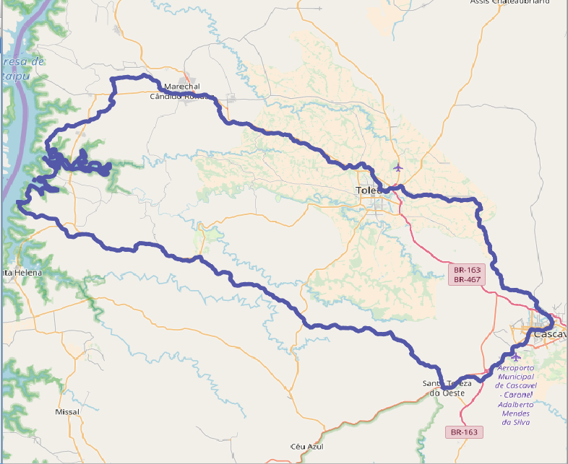
Analysis of NDVI Using QGIS
Click OK to get the following result in the QGIS window
Next Navigate to the NDVI folder and change the file names to make them short for convenience. For example: MOD13Q1_A2016033_h13v11_006_2016035114528_MODIS_Grid_16DAY_250m_500m_VI_250m_16_days_NDVI_2c47e848 can be renamed NDVI-2016033

Slide 17
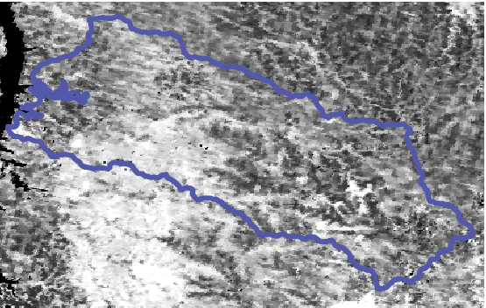
Analysis of NDVI Using QGIS
Click on the Add Raster function on the left and add NDVI-2016033
On the top bar go to Raster > Extraction > Clipper to open the Clipper options window
You will see Extent selected in the window
Enter Output file name by clicking on Select (Suggestion: Temp1.tif)
Drag the cursor across the map so that just the area around the shapefile is covered
You will then see the rectangular clipped layer on the map

Slide 18
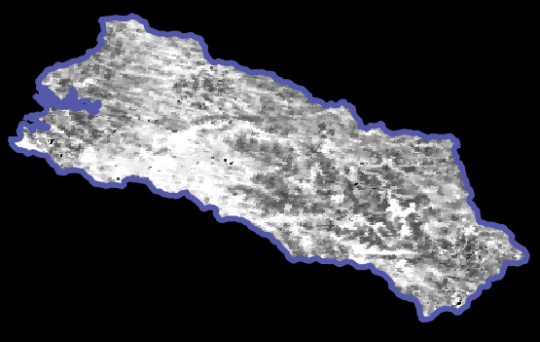
Analysis of NDVI Using QGIS
Clip the pre-clipped layer to the SFV shapefile
On the top menu, go to Raster > Extraction > Clipper to open the Clipper options window
In the Input File (raster) window, select the rectangular, clipped file Temp1
In the output file window, select output folder and enter a file name (Suggestion: NDVI_2016033-Clipped)
Check the Mask Layer and in the Mask Layer window select the shapefile named sfv_4326
Click OK on the bottom right
You should see the data clipped by the shapefile

Slide 19
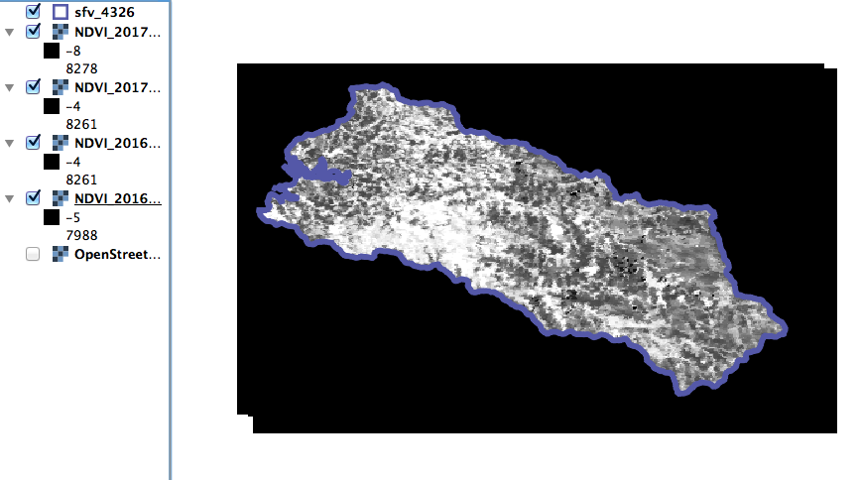
Analysis of NDVI Using QGIS
Repeat Step 10 for raster layers: NDVI_2016049, NDVI_2017033, NDVI_2017049
Repeat steps 11-21 with the two-step clipping of newly added raster layers, first with a rectangle and then using the shapefile
Save the final, clipped files as NDVI_2016049-clipped, NDVI_2017033-clipped, NDVI_2017049-clipped
Remove all NDVI layers other than the final clipped layers

Slide 20
Analysis of NDVI Using QGIS
Notice that the NDVI values in these layers are not within -1 and 1. The data has to be scaled by 0.0001. This is the scaling factor for MODIS images.
Along the top of your QGIS map, go to Raster > Raster Calculator
This function allows you to perform specific, mathematical expressions to your raster layers
In the box on the top left, double click on the NDVI_201633-Clipped@1 layer in the Raster bands to move that layer into the Raster calculator expression
Click on the multiplication function (*) and Type in 0.0001
The formula should look like: “NDVI_2016330Clipped@1” * 0.0001

Slide 21
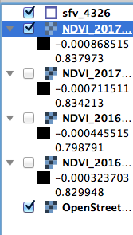
Analysis of NDVI Using QGIS
Give it an output name (Suggestion: NDVI_2016033-Scaled) in the Output layer box
Click on the button with 3 dots next to the box to ensure that you save your image to the correct folder
Leave all other settings as default, and make sure that the Add results to project box is checked. Click Ok.
Repeat steps 26-29 to scale all the NDVI layers
You will now see values between -1 to 1

Slide 22
Analysis of NDVI Using QGIS
Next, calculate the average NDVI for February 2016 by adding the two raster layers (003 and 049)
Next, calculate the average NDVI for February 2016 by adding the two raster layers (003 and 049)
Click on Raster > Raster calculator
Click on ( in the Operators window and then double click on the NDVI_201633-Scaled@1 raster layer in the Raster Band window
Add a + and double click on NDVI_2016049-Scaled@1 and then add ) * 0.5
You will get the following Raster calculation expression: (“NDVI_2016033-Scaled@1”+“NDVI_2016049-Scaled@1”)*0.5

Slide 23
Analysis of NDVI Using QGIS
Name the Output Layer as NDVI-Feb2016
Click Ok to get the NDVI for 2016
Repeat the raster calculation for February 2017 following Steps 36 and 37
You may want to remove all NDVI other layers other than the NDVI_Feb2016 and NDVI_Feb2017
The NDVI images are currently in black and white. As you recall, NDVI values range from 0 to 1, with 0 having no vegetation and 1 having the highest density vegetation. Generally, a good way to view an NDVI image is with a color ramp ranging from red (low NDVI values) to green (high NDVI values).

Slide 24
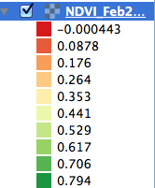
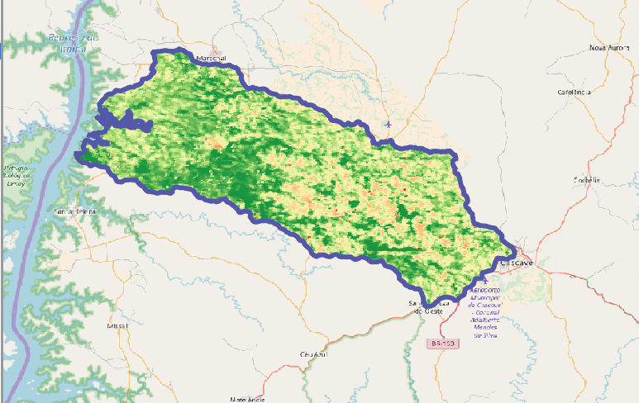
Analysis of NDVI Using QGIS
Click on NDVI_Feb2016, and select Properties > Style
Set the Render Type to be Singleband Pseudocolor
Under Color, set the color palette to be Red to Green (RdYlGn)
Set Min value to 0 and Max value to 1
Below the color display, change the Mode to Equal Interval and Classes to 10
Click Classify, Apply, and OK
Repeat steps 43-48 for NDVI_Feb2017

Slide 25
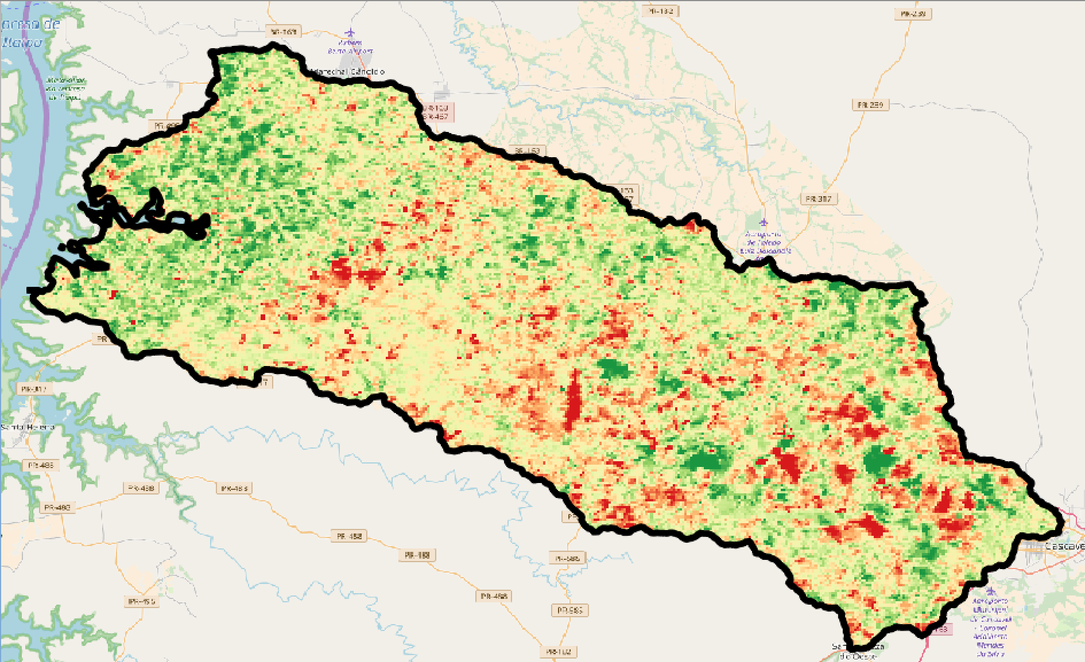
Inter-Annual Difference of NDVI
Take the difference of the NDVI by using Raster > Raster Calculator
Use the following expression to subtract the February 2017 NDVI from February 2016:
“NDVI_Feb2016@1” – “NDVI_Feb2017@1”
Name the Output Layer NDVI_Difference
Click Ok to get the difference
Color the image by following steps 43-48 for the NDVI_Difference layer

Slide 26
Discussion Questions
Examine the NDVI maps of February 2016 and 2017. Which year shows more green vegetation?
Compare the NDVI maps with the Landsat Tree Cover Map from the previous exercise – do you see any similarity? Explain.
Examine the NDVI difference map. What are the regions where the NDVI differences are large (showing excess and deficit)?
4. For what applications would you use NDVI?

